Slide 1
Start-up Success Prediction
Lama Alharbi
T5o03
Metis Bootcamp

Slide 2


Problem Statement
9 out of 10 startups fail
Failure to raise new capital
No Market need
Notes:
https://www.cbinsights.com/research/startup-failure-reasons-top/
https://www.embroker.com/blog/startup-statistics/

Slide 3

Goal
Build a robust model to predict the success of a Startup
Determine the main reasons behind the success of a Startup
Notes:
https://www.cbinsights.com/research/startup-failure-reasons-top/
https://www.embroker.com/blog/startup-statistics/

Slide 4

Dataset
49438 Rows
Each row represent a company
39 Features
Notes:
https://www.cbinsights.com/research/startup-failure-reasons-top/
https://www.embroker.com/blog/startup-statistics/

Slide 5
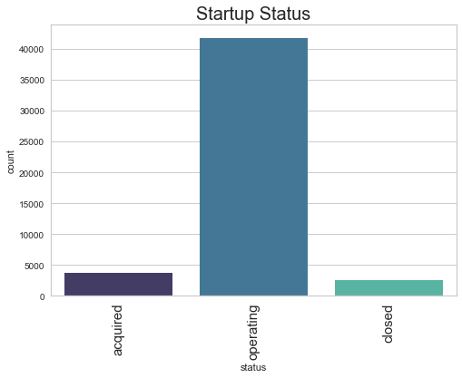

Slide 6
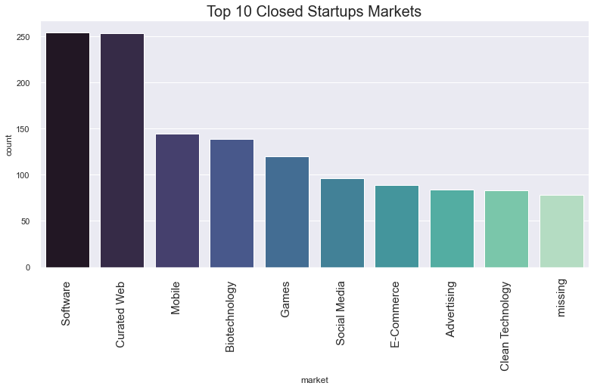

Slide 7
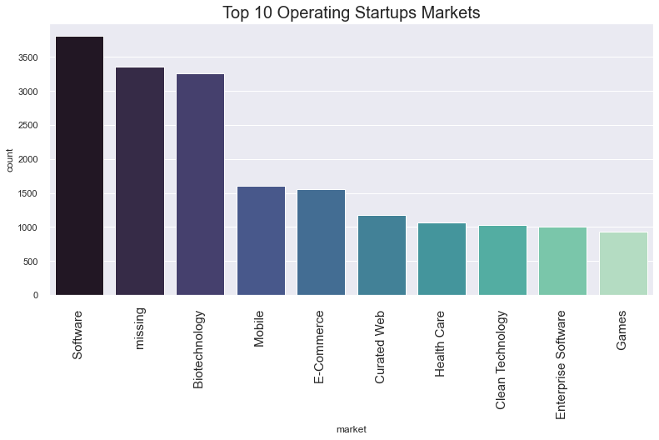

Slide 8
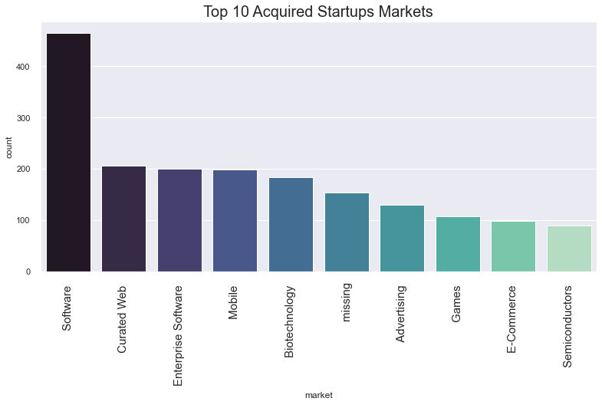

Slide 9
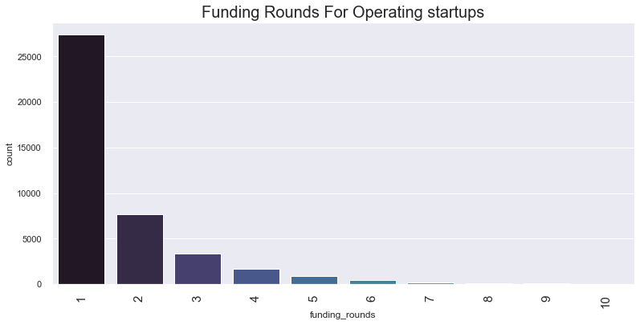

Slide 10
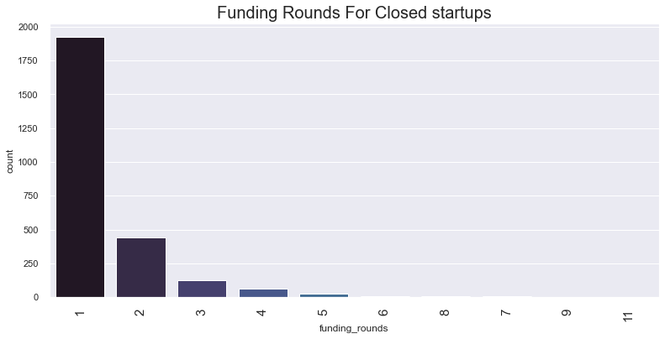

Slide 11
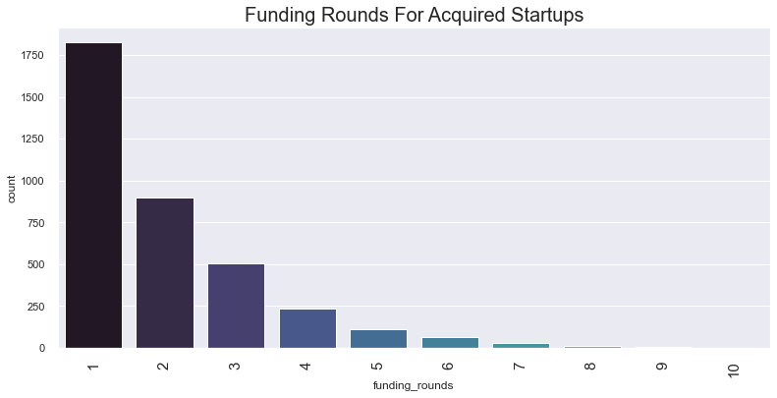

Slide 12
Project Steps
1
2
3
4
5
Cleaning
EDA
Encoding
Balancing
Classify
Removing duplicates
Replacing null values
Converting datatypes
Understand the data
Visualize the features
Encoding the
Categorical features
Balance the data
Using Smote and ROS
Build a random forest
Classification model
Validate using CV

Slide 13
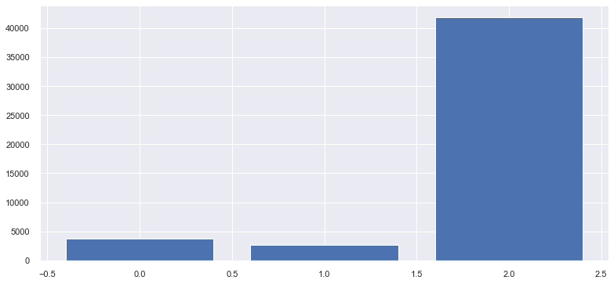
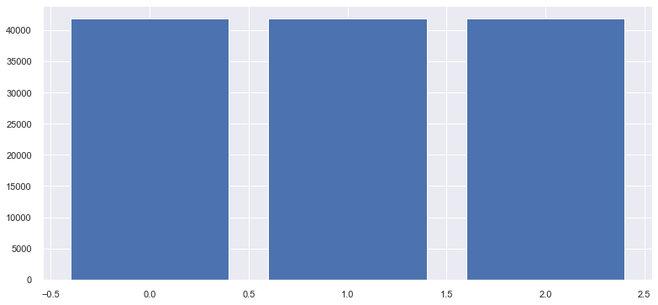
Classes before and after SMOTE
Classes Encoding:
0: acquired
1: closed
2: operating

Slide 14
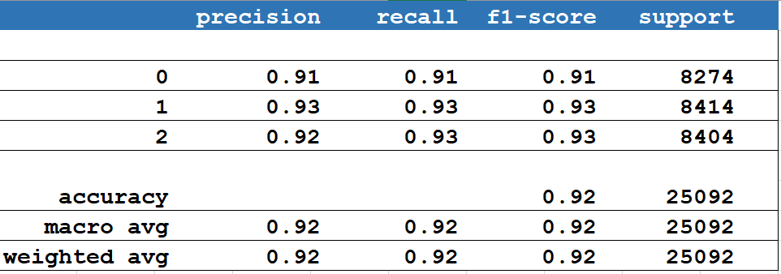
Random Forest with SMOTE Evaluation
Training
Accuracy
Testing
Accuracy
%91
%92

Slide 15
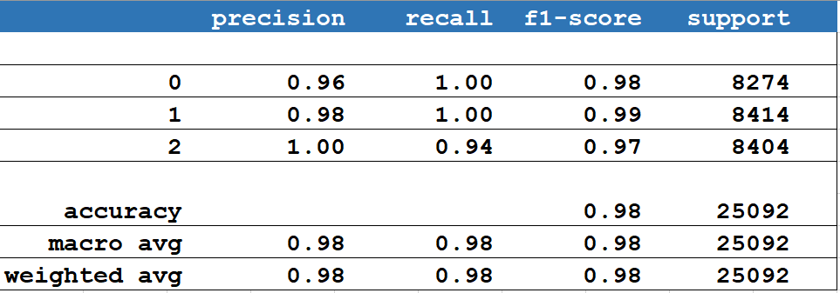
Random Forest with ROS Evaluation
Training
Accuracy
Testing
Accuracy
%97
%97

Slide 16
Features Importance in random forest with SMOTE
Last funding year
01
funding amount
06
02
Country
First year of funding
05
03
The period between founding year and first year of funding
04
Number of funding rounds

Slide 17
Features Importance in Random forest with ROS
Funding Amount
01
Last funding year
06
02
The period between founding year and first year of funding
First year of funding
05
03
Founding year
04
Venture

Slide 18
Conclusion

Slide 19
Any Questions?

Slide 20
Instructions for use (free users)
In order to use this template, you must credit Slidesgo by keeping the Thanks slide.
You are allowed to:
Modify this template.
Use it for both personal and commercial purposes.
You are not allowed to:
Sublicense, sell or rent any of Slidesgo Content (or a modified version of Slidesgo Content).
Distribute this Slidesgo Template (or a modified version of this Slidesgo Template) or include it in a database or in any other product or service that offers downloadable images, icons or presentations that may be subject to distribution or resale.
Use any of the elements that are part of this Slidesgo Template in an isolated and separated way from this Template.
Delete the “Thanks” or “Credits” slide.
Register any of the elements that are part of this template as a trademark or logo, or register it as a work in an intellectual property registry or similar.
For more information about editing slides, please read our FAQs or visit Slidesgo School:
https://slidesgo.com/faqs and https://slidesgo.com/slidesgo-school

